Slide 1
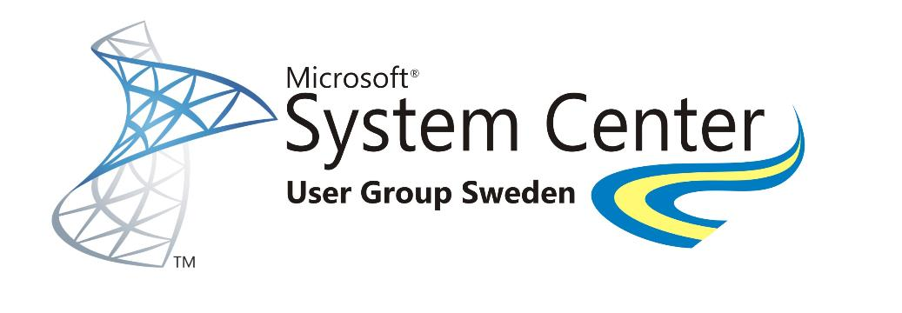





What´s new in Windows Server 2016 and System Center 2016… and Azure Stack
Richard Ulfvin, CTO Addlevel
www.scug.se

Slide 2

C:\> whoami
@Ulfvin
www.scug.se

Slide 3
“The software-defined datacenter”
www.scug.se

Slide 4
Looking back
Windows Server 2008 R2
System Center 2007 R3
Windows Server 2012
System Center 2012
Windows Server 2012 R2
System Center 2012 R2
Microsoft Azure
Introduced virtualization platform/ management
Industry-leading scale and performance
Azure as design point
www.scug.se

Slide 5
Looking ahead
Windows Server 2008 R2
System Center 2007 R3
Windows Server 2012
System Center 2012
Windows Server 2012 R2
System Center 2012 R2
Microsoft Azure
Windows Server 2016
System Center 2016
Microsoft Azure
Introduced virtualization platform/ management
Industry-leading scale and performance
Cloud-first innovation: Infrastructure and application platform
Azure as design point
www.scug.se

Slide 6
Windows Server 2016
Storage
Network
Compute
Security
www.scug.se

Slide 7
Storage
In place cluster upgrade
Removes the requirement for the traditional drain / evict workflow
Mixed version clusters are supported
Allows VM’s to live migrate and failover between Hyper-V host versions
www.scug.se

Slide 8

Storage Spaces Direct
Cloud design points and management
Standard servers with local storage
New device types such as SATA and NVMe SSD
Prescriptive hardware configurations
Deploy/manage/monitor with SCVMM, SCOM & PowerShell
HYPER-V CLUSTER(S)
Reliability, scalability, flexibility
Fault tolerance to disk, enclosure, node failures
Scale pools to large number of drives
Simple and fine grained expansion
Fast VM creation and efficient VM snapshots
SMB3 STORAGE NETWORK FABRIC
SCALE-OUT FILE SERVER CLUSTER
Use cases
Hyper-V IaaS storage
Storage for backup and replication targets
Hyper-converged (compute and storage together)
Converged (compute and storage separate)
www.scug.se

Slide 9

Storage Spaces Direct Deploy
Converged (Disaggregated)
Hyper-converged
Compute and Storage resources together
Compute and Storage scale and are managed together
Typically small to medium sized scale-out deployments
Compute and Storage resources separate
Compute and Storage scale and are managed independently
Typically larger scale-out deployments
HYPER-V CLUSTER
HYPER-V CLUSTER(S)
SMB3 STORAGE NETWORK FABRIC
SCALE-OUT FILE SERVER CLUSTER
www.scug.se

Slide 10
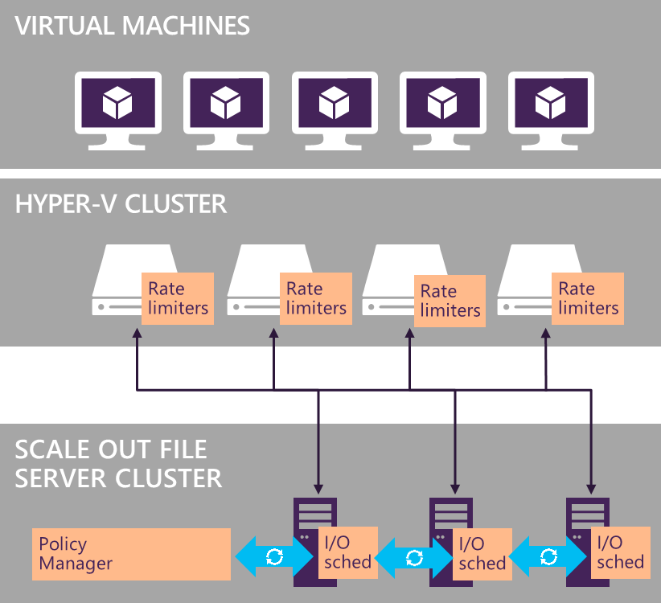
Storage Quality of Service
Profiler and Rate Limiter on Hyper-V compute nodes
1
I/O Scheduler distributed across the storage nodes
1
2
Centralized Policy Manager on Scale-Out File Server Cluster
3
2
Silver
Policy
3
Gold
Policy
www.scug.se

Slide 11
Storage Replica
Replication Block-level, volume-based
Synchronous & asynchronous
SMB 3.1.1 transport
Flexibility
Any Windows data volume
Any fixed disk storage
Any storage fabric
Management
Failover Cluster Manager
Windows PowerShell & WMI
Azure Site Recovery
End to end MS Storage Stack
www.scug.se

Slide 12
Network
Network controller
Centralized policy management
IPAM
Tracking activity
IP Utilization
Hyper-V swith enhencements
Tracking activity
IP Utilization
www.scug.se

Slide 13
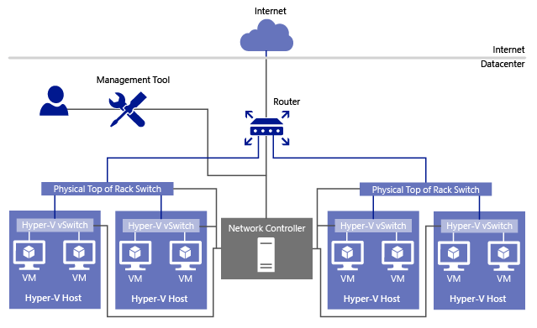
Network Controller
Fabric Network Management
IP Subnets, VLANS, L2 and L3 switches, Host NICs
Auto discovery
Firewall Management
Allow/Deny rules, vSwitch port of VMs, Logging
Service Chaining
Rules for redirecting traffic to one or more
virtual appliances
Scalable software load balancer
Replaces NLB
Full scale out and distributed topology
www.scug.se

Slide 14
Compute
XXX
www.scug.se

Slide 15
Compute Hyper-V
Production checkpoints
Rely on backup technology within the VM (not saved state).
VSS or flushing file system buffers (Linux)
Hot add/remove net adapter and memory
No need to restart VM
Nested Hyper-V
Run VMs inside VMs
PowerShell Direct
Improved management with direct execution of PowerShell
www.scug.se

Slide 16
Compute Nano
Optimized for next-gen distributed applications Higher density and Reduced attack surface and servicing requirements
Next-gen distributed app frameworks (Windows Server App)
Interoperate with existing server applications
Containers and next-gen applications
Nano Server
Just enough OS
www.scug.se

Slide 17
Compute Containers
Windows PowerShell
Copyright (C) 2016 Microsoft Corporation. All rights reserved.
PS C:\> New-Container
PS C:\> Get-Container
PS C:\> Get-ContainerImage
Docker Client
PowerShell
Docker Compose
Docker Registry
Docker Swarm
Docker Engine
Operating System
www.scug.se

Slide 18
…and security…
Credential Guard Prevents Pass the Hash and Pass the Ticket attacks by protecting stored credentials through Virtualization based Security
Just Enough Administration Limits administrative privileges to the bare-minimum required set of actions (limited in space)
Just in Time Administration Provide privileged access through a workflow that is audited and limited in time
JEA + JIT = limited in time & capability
www.scug.se
Notes:
Credential Guard: Based on Windows 10, Credential Guard use Virtualization Based Security to protect credentials on the system from being stolen by compromised administrator or malware.
Just In Time Administration: Move from perpetual administration to time based administration. When a user needs to be an administrator, they go through a workflow that is fully audited and provides them with administration privilege for a limited amount of time after which that privilege gets revoked.
Just Enough Administration: Administrators should only be able to do their role and nothing more. For example: A File Server administrator can restart services but should not be able to browse the data on the server.
Graphic explanation: JEA and JIT and independent and complement each other. By combining the two technologies, we can limit the amount of capabilities provided to an administrator, while maintaining the minimum required to accomplish their tasks and also limiting the time on which these administrators can perform these tasks.

Slide 19
…and more security…
Code Integrity Ensure that only permitted binaries can be executed from the moment the OS is booted
Windows Defender Actively protects from known malware without impacting workloads
Control Flow Guard Protects against unknown vulnerabilities by blocking common attack vectors
www.scug.se
Notes:
Code Integrity (Device Guard): Uses Virtualization Based Security to ensure that only allowed binaries can be run on the system.
Built in anti-malware: Windows Defender is installed and functional on Windows Server 2016. Windows Defender has been optimized to run on server supporting the various server roles and integrated with PowerShell for malware scanning.
Control Flow Guard: Serves as a safeguard by preventing common attack vectors in case the system has unknown vulnerabilities. Control Flow Guard (CFG) is a highly-optimized platform security feature that was created to combat memory corruption vulnerabilities. By placing tight restrictions on where an application can execute code from, it makes it much harder for exploits to execute arbitrary code through vulnerabilities such as buffer overflows

Slide 20
…and even more security!
Shielded VMs Use BitLocker to encrypt the disk and state of virtual machines protecting secrets from compromised admins & malware
Host Guardian Service Attests to host health releasing the keys required to boot or migrate a Shielded VM only to healthy hosts
www.scug.se
Notes:
Code Integrity (Device Guard): Uses Virtualization Based Security to ensure that only allowed binaries can be run on the system.
Built in anti-malware: Windows Defender is installed and functional on Windows Server 2016. Windows Defender has been optimized to run on server supporting the various server roles and integrated with PowerShell for malware scanning.
Control Flow Guard: Serves as a safeguard by preventing common attack vectors in case the system has unknown vulnerabilities. Control Flow Guard (CFG) is a highly-optimized platform security feature that was created to combat memory corruption vulnerabilities. By placing tight restrictions on where an application can execute code from, it makes it much harder for exploits to execute arbitrary code through vulnerabilities such as buffer overflows

Slide 21
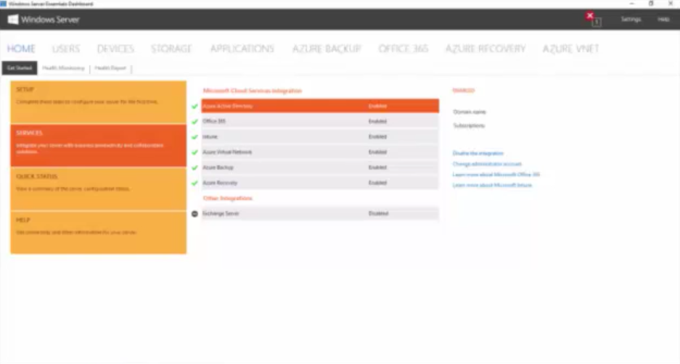
Online Integration
Easily add cloud identities to on-premises users
Replaces Azure Active Directory Connect
Easily assign Office 365 licenses
SharePoint Online settings
Exchange Mailbox sizes
Mobile Device Management
www.scug.se

Slide 22
Management with System Center
Virtual Machine Manager Nano Server Support Production Checkpoints Rolling Cluster Updates Memory and NetAdapter Online Changes ShieldesVMs via VMM/WAP Manage Storage Spaces Direct Manage Replicated Volumes Manage Storage QoS Manage SDN
Orchestrator / SMA Native PS Support ISE Plugin WMF/PS 5.0 Support
Operations Manager Network MP Generator MP Update and MP Tuning Scheduled MW Platform and Scalability Console Improvements
www.scug.se
Notes:
Nano Server Support
Production Checkpoints
Rolling Cluster Updates
Memory and NetAdapter Online Changes
ShieldesVMs via VMM/WAP
Create
Convert
Manage Storage Spaces Direct
Manage Replicated Volumes
Manage Storage QoS
Manage SDN
Gateways / Flexible Gateways
Load Balancer
Port ACL

Slide 23
Rethink your datacenter
Traditional model
Dedicated infrastructure for each application
Purpose-built hardware
Distinct infrastructure and operations teams
Customized processes and configurations
Cloud model
Loosely coupled apps and micro-services
Industry-standard hardware
Service-focused DevOps teams
Standardized processes and configurations
www.scug.se
Notes:
Nano Server Support
Production Checkpoints
Rolling Cluster Updates
Memory and NetAdapter Online Changes
ShieldesVMs via VMM/WAP
Create
Convert
Manage Storage Spaces Direct
Manage Replicated Volumes
Manage Storage QoS
Manage SDN
Gateways / Flexible Gateways
Load Balancer
Port ACL

Slide 24
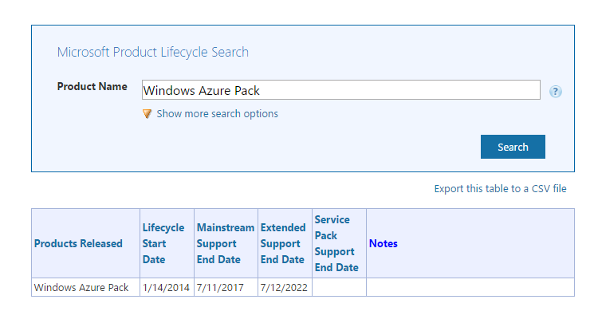
Windows Azure Pack
https://support.microsoft.com/en-us/lifecycle
www.scug.se
Notes:
Nano Server Support
Production Checkpoints
Rolling Cluster Updates
Memory and NetAdapter Online Changes
ShieldesVMs via VMM/WAP
Create
Convert
Manage Storage Spaces Direct
Manage Replicated Volumes
Manage Storage QoS
Manage SDN
Gateways / Flexible Gateways
Load Balancer
Port ACL

Slide 25
Azure Stack
Azure + Azure Stack = Hybrid
Apps should take advantage of Hybrid
Apps should be designed for Hybrid
Microsoft is fully committed to make you successful on this journey
Call To Action
Learn and try the Azure APIs and Template Authoring
https://azure.microsoft.com/en-us/documentation/
Try out the Azure Stack Technical Preview
https://azure.microsoft.com/en-us/overview/azure-stack/
Try the apps in the Github
Azure: https://github.com/Azure/azure-quickstart-templates
Azure Stack: https://github.com/Azure/AzureStack-QuickStart-Templates
www.scug.se
Notes:
Nano Server Support
Production Checkpoints
Rolling Cluster Updates
Memory and NetAdapter Online Changes
ShieldesVMs via VMM/WAP
Create
Convert
Manage Storage Spaces Direct
Manage Replicated Volumes
Manage Storage QoS
Manage SDN
Gateways / Flexible Gateways
Load Balancer
Port ACL

Slide 26
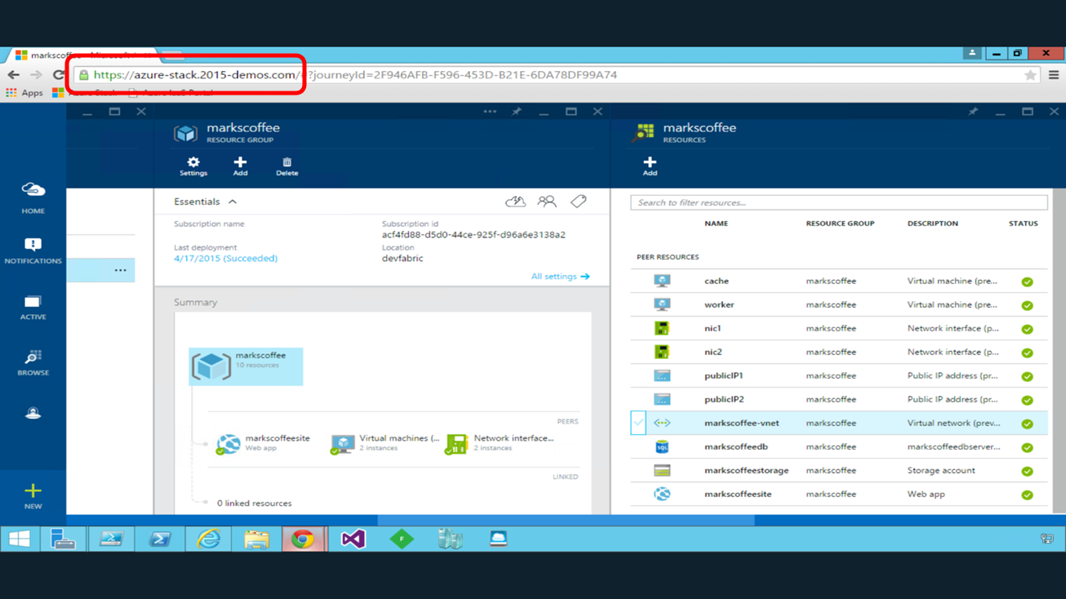
Cloud
www.scug.se
Notes:
Nano Server Support
Production Checkpoints
Rolling Cluster Updates
Memory and NetAdapter Online Changes
ShieldesVMs via VMM/WAP
Create
Convert
Manage Storage Spaces Direct
Manage Replicated Volumes
Manage Storage QoS
Manage SDN
Gateways / Flexible Gateways
Load Balancer
Port ACL

Slide 27
More
Networking in Windows Server 2016
https://channel9.msdn.com/Events/Ignite/Australia-2015/INF324
Free E-book Windows Server 2016
https://blogs.technet.microsoft.com/askcore/2016/04/27/free-ebook-introducing-windows-server-2016-technical-preview
www.scug.se
Notes:
Nano Server Support
Production Checkpoints
Rolling Cluster Updates
Memory and NetAdapter Online Changes
ShieldesVMs via VMM/WAP
Create
Convert
Manage Storage Spaces Direct
Manage Replicated Volumes
Manage Storage QoS
Manage SDN
Gateways / Flexible Gateways
Load Balancer
Port ACL

Slide 28


Sponsors
www.scug.se

Slide 29



System Center User Group
www.scug.se
www.youtube.com/scugse
#scugse
www.scug.se

